Slide 1
Discovering your superpowers! Understanding Cloud Application Models

Slide 3

Ryan Nowak
Azure Incubations (Azure CTO’s Office)
Formerly: ASP.NET Core architect for MVC/Razor/Blazor
Current Focus: Open Application Model - https://oam.dev/
I like:
Designing useful tools for developers
Open Source
Lots of different languages and technologies
@aVerySpicyBoi
rynowak (github)

Slide 4
Agenda
What is an Application Model?
How can we think systematically about cloud runtimes?
Superpowers!
How can we learn new cloud technologies faster?
How can we be more productive?
How can we write application code that’s more flexible?

Slide 5
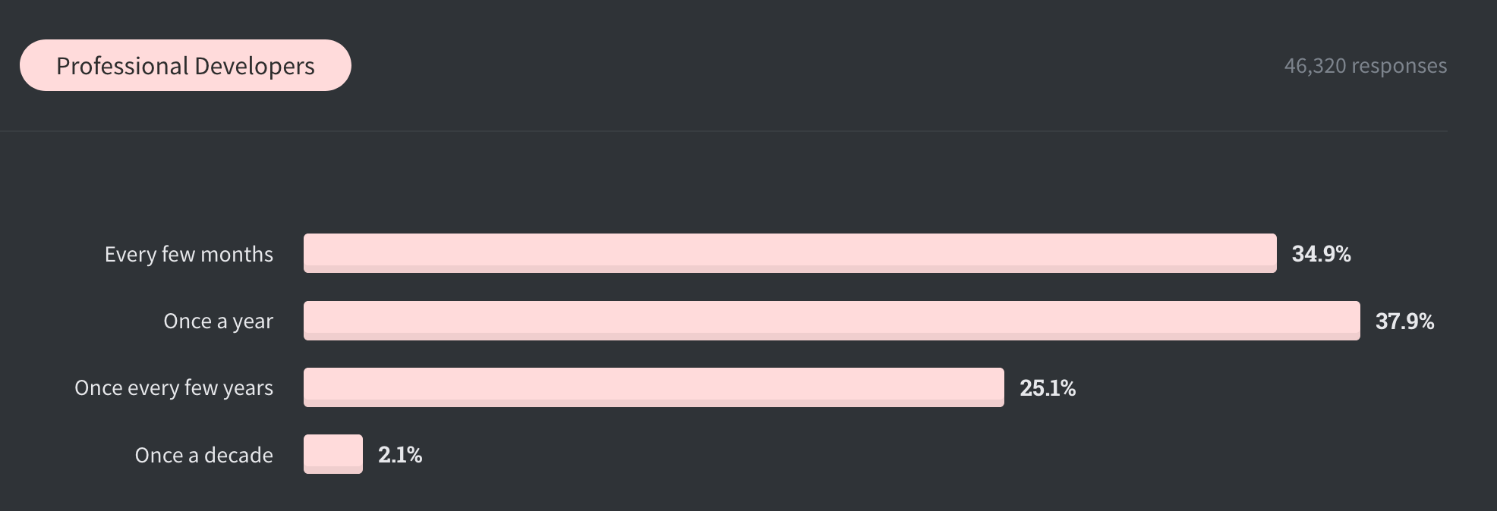
How often do you learn a new technology?
From: Stack Overflow 2020 developer survey

Slide 6
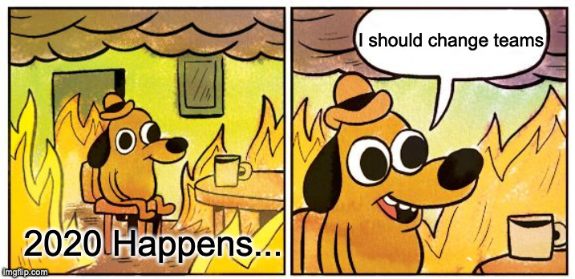
My Journey in 2020
In the last few years:
I’ve had many conversations with .NET developers about microservices
We organize surveys, interviews, and trials for .NET microservices tech
Everything except your code is a pain point for developers!
I moved to Azure:
Now I’m working on solutions to these problems

Slide 7
What is an Application Model?

Slide 8
A useful definition
An Application Model describes the interface between software components and a runtime environment..
Me

Slide 9
Some Examples
Software Components
Process
Container
Interface
Environment Variables
Runtime Environment
OS
Docker
"Hosted" Application
Networking
Files
Kubernetes
FaaS (Azure Functions)
Website PaaS (Azure Web Apps)
Deployment
Platform behaviors (many more)

Slide 10
When I talk to developers…
Learning cloud technologies like Kubernetes or Docker is frustrating
Development and production are different
My theories:
We deploy as the last step … it works on my machine and then …
We become users ... we learn someone else’s software but ...
The concepts we understand don’t match the features offered

Slide 11
Impedance mismatch
Alternate title: Different levels of abstraction
Connect to database
Environment variables

Slide 12
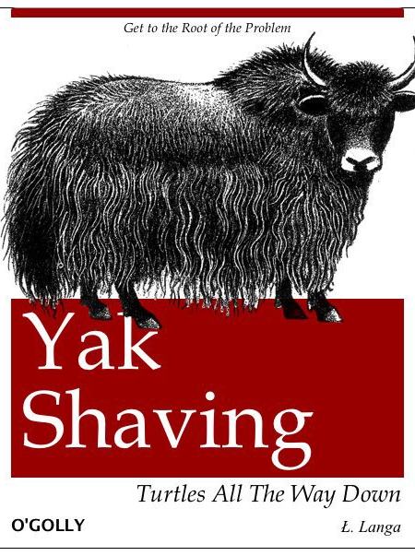
Yak Shaving
To connect to a database we must:
Choose an environment variable name
Figure out the right connection string
Figure out how to set an environment variable in the deployment platform (without checking in a secret)
Test it in production (and repeat if you got it wrong)
Now figure out the next problem and repeat

Slide 13
Applying systematic thinking

Slide 14
Planning: For each Service
What does this service need?
What needs to be deployed?
Communication with other services? Data stores? Credentials?
What settings does it expose?
What kinds of diagnostics systems do I need? (Logging at a minimum)
Understand the capabilities of the platform
What options does it provide?
What are the tradeoffs of those options?
Map the needs to the capabilities
Write the manifests and deploy!

Slide 15
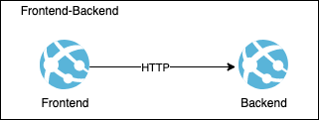
Planning: Our First App

Slide 16
Our First App: What does this service need?
What needs to be deployed?
Both are ASP.NET Core 3.1 applications – so we need that!
Communication?
Backend: Needs to listen for HTTP so frontend can talk to it
Frontend: Needs to listen for HTTP so users can browse to it
Frontend: Needs to know the address of Backend so it can talk to it
What settings does it expose?
Backend: None
Frontend: None
What diagnostics?
Logging

Slide 17
Introducing the Process

Slide 18
What did we find?
Communication
Configuration
Diagnostics
Deployment
Ports
Files
Environment Variables
Console I/O
Files
Process
Command Line

Slide 19
Being Productive with Processes
Manual management of:
Ports/URLs
File Locations
One process is really easy
3-4 related processes gets out of control
You can script it, but it is hard to maintain
We developed Tye to make this easy: https://aka.ms/tye

Slide 20
Something Special: Hosted Environments
You don’t get to run a process (kinda)
Ex: IIS, Azure Functions
Host runs code in your process
Usually this comes with an SDK
Networking is controlled by the host
You don’t choose a port to listen on
The host provides a deployment format
This is usually a zip file plus a manifest

Slide 21
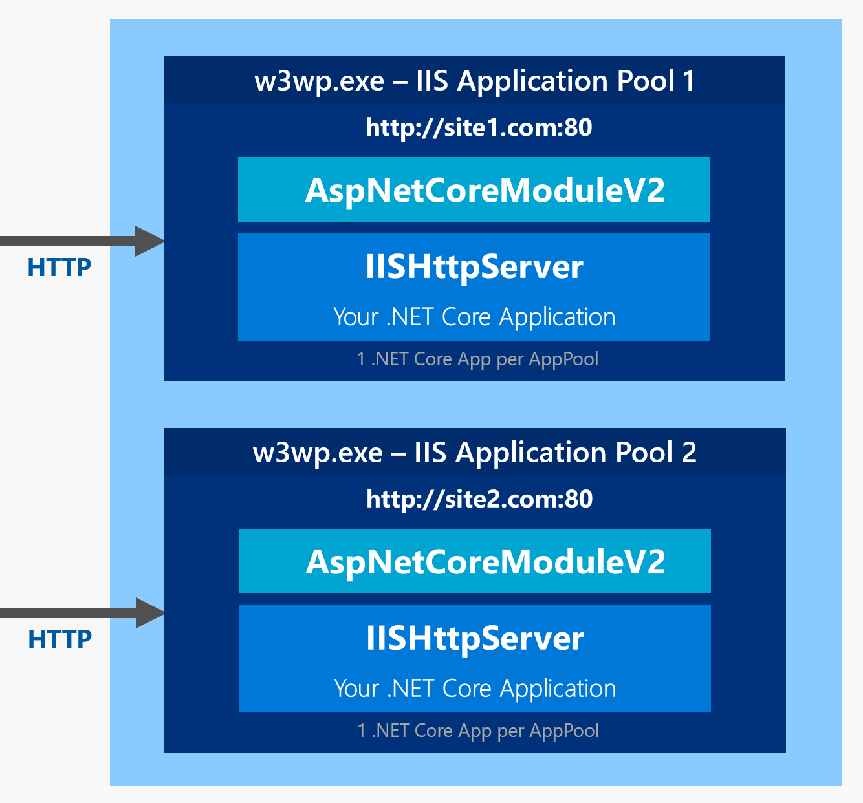
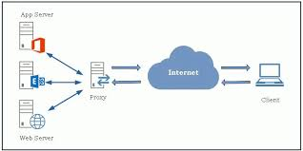
Two models
Reverse Proxy
In-Process Hosting

Slide 22
Two Models
Reverse Proxy
In-Process Hosting
Communication happens over sockets
Your application could be *anything*
You choose an address and configure the server to point at it
No SDK for interacting with proxy in code (you figure out diagnostics, lifecycle)
Communication happens through API
Your application must be a supported platform of the server
Server manages address, configuration
Comes with SDK for diagnostics, lifecycle, rich API
Ex: IIS, Azure WebSites, Tomcat

Slide 23
Two Models
Old ASP.NET (.NET Framework) uses the In-Process model and is coupled to IIS & Windows
System.Web.dll is a tightly coupled to IIS’s architecture and API
Some projects of that generation supported non-IIS (Katana)
ASP.NET Core used the Reverse Proxy architecture on release
Kestrel server was first based on LibUV (used in node) as a cross-platform standalone server
We made heavy investments in System.Net.Socket and far surpassed LibUV over the years
IIS has a module for Reverse Proxy integration (used in Azure WebSites)
This was slow and diagnostics were bad compared to ASP.NET Core without IIS
We implemented In-Process support in 2.2 without coupling ASP.NET Core to Windows

Slide 24
An Observation
A system can either prescribe a configuration or require a human to set the configuration.
Ryan Nowak

Slide 25
And then for a long time nothing happened…

Slide 26
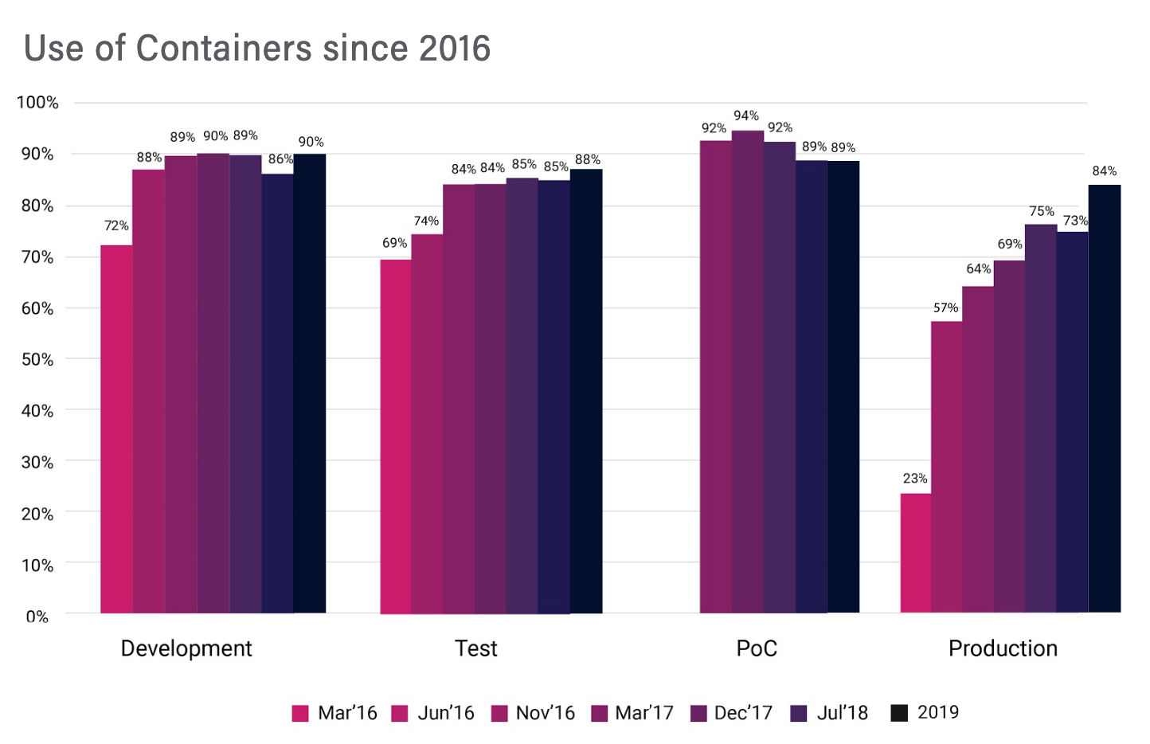
Introducing Containers
CNCF survey

Slide 27
Introducing Containers

Slide 28
What did we find
Communication
Configuration
Diagnostics
Deployment
Ports (Isolated)
Files (Isolated)
Environment Variables
Console I/O
Files (Isolated)
Container
Base Image (Dependencies)
Command Line

Slide 29
Being Productive with Containers
Ports and files are now isolated
Now we have consistency instead of random numbers to remember
Can bake configuration into the image
Files and startup command are part of the image
Environment variables still useful for overrides
Deployment is more powerful and foolproof
Versioning/naming of images
Ability to use registries for storage
Can ship arbitrary dependencies and OS configuration in image

Slide 30
This sounds great right?
Except Dockerfiles are really painful ☹
Easy to copy-paste and therefore a lot of copies to maintain
Usually 1-2 people on the team really know how it works
Optimizing your Docker build for size increases the complexity
2-phase build makes it hard to use P2P references or shared build assets
I don’t know anyone who thinks this is easy and fun…

Slide 31
My controversial advice
Think hard about what you want to optimize for
Don’t copy techniques from native-code platforms for “best practices” reasons
Optimize for maintainability until you need to optimize for something else
You could consider generating Dockerfiles from a template
Recipes that work:
(service-per-repo) Copy whole repo into Container and build (2-phase) inside – very flexible
(few dependencies) Publish files with a script and build with CLI (1-phase) – no Dockerfiles!
(smallest total size) Use the linker with a standalone publish – final layer will be big but total size small

Slide 32
More than one at a time

